Slide 1


School of Basic and Applied Sciences
Course Code : BBS01T1002 Course Name: Semiconductor Physics
Effective Mass and Concept of Holes
Name of the Faculty: Dr. Aakash Mathur Program Name: B.Tech

Slide 2
Topics to be covered
:
Preliminary ideas of E-K diagram
Introduction
Derivation of Effective Mass
Concept of Holes
References
Name of the Faculty: Dr. Aakash Mathur

Slide 3
Objectives
Derive and apply concept of Effective Mass
Explain concept of holes

Slide 4
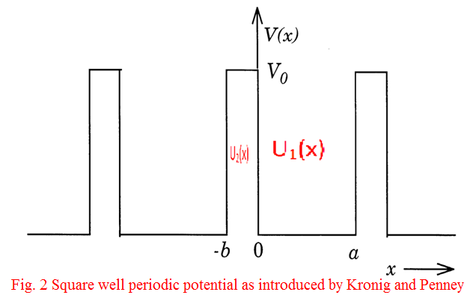
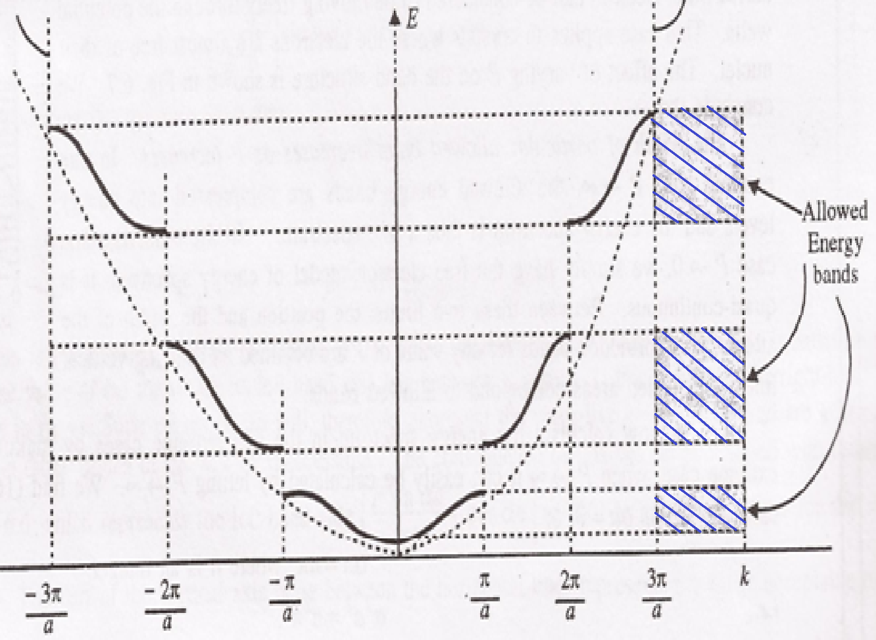
Prerequisite/Recapitulations
:
In a periodic potential lattice, the electron energy values are discontinuous, separated into allowed and forbidden zones occurring alternatively.
The width of the forbidden band increases with E.
As P decreases, the perturbations of the potential due to periodicity of the lattice vanish, making electrons really free, the discontinuous E-K graph will reduce to a continuous parabolic graph as shown by dotted lines and the forbidden bands disappear which is appropriate to the completely free particle. The dotted curve shows the parabola of free electron i.e.,
E=
Name of the Faculty: Dr. Aakash Mathur

Slide 5
Introduction
A free electron has well defined mass and obeys Newton’s law when accelerated by an external electric field; but when electron is in periodic potential of the crystal lattice, its behaviour in external electric field is different from that of a free electron. The deviation of the actual electron behaviour than free electron behaviour may be accounted simply by considering the electron to have effective mass, m* rather than free electron mass m.
Name of the Faculty: Dr. Aakash Mathur Program Name: B.Tech

Slide 6
Effective Mass
.
According to wave mechanical theory (de-Broglie) an electron with velocity v is equivalent to a wave packet moving with group velocity v_{g}
............................(1)
where ω is the angular frequency of de-Broglie wave and K = 2π/λ is propagation constant.
The energy of particle
Now equation (1) gives
........................................................ (2)
Name of the Faculty: Dr. Aakash Mathur Program Name: B.Tech

Slide 7
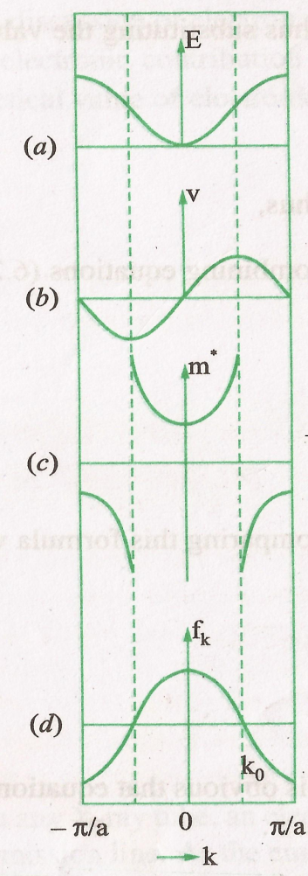
Effective Mass
For free particle,
Then, from Eqn (2)
.
This gives linear variation of v with K.
But according to band theory (with periodic potential) of electron, E is not, in general, proportional to K², there the variation of E with K is as shown in Fig.(a). Using this type of variation of E with K and using equation (2), one can calculate the velocity v, this gives a curve of the type illustrated as in Fig (b). We observe that the velocity of the electron varies with the slope.
Name of the Faculty: Dr. Aakash Mathur Program Name: B.Tech

Slide 8
Effective Mass
For K=0 and K= ± π/a, the slope, dE/dK is zero, thus the velocity of the electron is zero at bottom as well as the top of the first Brillouin Zone.
After K=0, as the value of K increases (i.e., the energy E increases), the velocity increases reaching its maximum value at K=K₀ where K₀ corresponds to the point of inflection on the E-K graph. Beyond this point the velocity begins to decrease and finally assumes the zero value at K=π/a which is the top of the band.
It is significant to note that the decrease of the velocity beyond this point of inflection (with increase in energy) and its zero value at the top of the band are the entirely new features which do not appear at all in the behaviour of free electron.
Name of the Faculty: Dr. Aakash Mathur Program Name: B.Tech

Slide 9
Effective Mass
Acceleration and effective mass of electron:
When an electron has a well defined mass and accelerated by an electric field, it obeys Newtonian mechanics. Now, we will discuss the behaviour of electron when it is to be accelerated inside a crystal due to external electric field.
.
When an electric field
is applied on the electron, then force on electron
Work done by electric field over a small distance dx travelled in time dt is
dE= -eX_{e} dx = -eX_{e} v dt
Substituting value of v from equation (2), we get
Name of the Faculty: Dr. Aakash Mathur Program Name: B.Tech

Slide 10
Effective Mass
Acceleration and effective mass of electron:
Differentiating eqn (2) with respect to time
, --------(4)
When we compare this result with the acceleration of a free electron of mass m i.e.
---------(5)
Compare eqn. (4) and (5) it follows that an electron in the periodic lattice behaves as an electron of effective mass m* given by
Name of the Faculty: Dr. Aakash Mathur Program Name: B.Tech

Slide 11
Effective Mass
Acceleration and effective mass of electron:
Clearly the effective mass of electron is determined by d²E/dK² and is a function of K is no longer a strict constant.
It indicates the importance of E-K curves for the motion of electron. [(Fig (c)] represents the effective mass (m*) of the electron as a function of K.
It increases with increase of K, becomes maximum at point of inflexion and then it becomes negative. The behaviour of the effective mass is as follows
It increases with increase of K, becomes maximum at point of inflexion and then it becomes negative.
Name of the Faculty: Dr. Aakash Mathur Program Name: B.Tech

Slide 12
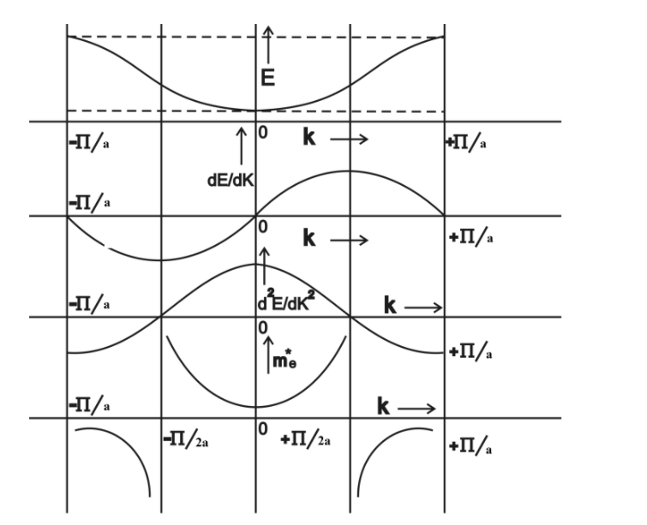
Effective Mass
Name of the Faculty: Dr. Aakash Mathur Program Name: B.Tech

Slide 13
Concept of Holes
The behaviour of the effective mass is as follows
m* is positive in the lower half of the energy band
m* is negative in the upper half of the energy band.
Physically it means since this region is now close to the top of the band that in upper half of the band, electron behaves as a positively charged particle. The negative mass can be seen dynamically by noting that the velocity decreases, thus acceleration negative i.e., opposite to the applied force, implying a negative mass. This means that in this region the lattice exerts such a large retarding force on the electron that it overcomes the applied force and produces a negative acceleration. Here the band behaves as a positively charged particle referred to as a hole.
At inflexion points (K=K₀) in E-K curves, the effective mass m* becomes infinite.
Name of the Faculty: Dr. Aakash Mathur Program Name: B.Tech

Slide 14
Concept of Holes
For a free electron,
But for a periodic potential, m* ≠ m
It may be concluded that all the results of the free electron are correct provided m in each case is replaced by suitable m*. Accordingly energy in periodic potential will be given by
This is known as the effective mass approximation.
As a summary, in the periodic potential, the electron in the crystal will thus behave dynamically just like a particle with variable effective mass and the whole effect of the periodic potential on the motion of the electron is to replace the free electron mass with proper effective mass.
Name of the Faculty: Dr. Aakash Mathur Program Name: B.Tech

Slide 15
Degrees of Freedom
The degree of freedom of an electron in periodic potential is defined by a factor
f_{K} is a measure of the extent to which an electron in state K is free.
If m* is large, i.e. the electron behaves as a heavy particle. When f_{k} = 1, the electron behaves as free particle, Fig. (d) represents the plot of f_{K} against K. It may be noted that f_{K} is positive in the lower half of the band and negative in upper half.
Name of the Faculty: Dr. Aakash Mathur Program Name: B.Tech

Slide 16
Practice Questions
Draw and explain E-K diagram.
2. Draw and explain Brillouin zones in one dimension
Name of the Faculty: Dr. Aakash Mathur Program Name: B.Tech

Slide 17
School of Basic and Applied Sciences
Course Code : BBS01T1002 Course Name: Semiconductor Physics
References
1. J. Singh , Semiconductor optoelectronics, Physics and Technology, Mc-Graw –Hill Inc. 1995.
2. S.M. Sze, Semiconductor Devices: Physics and Technology, Wiley 2008.
3. Pillai S O, Solid State Physics,( 2010), sixth edition, New Age International (P) Ltd. ISBN-9788122427264.
Name of the Faculty: Dr. Aakash Mathur Program Name: B.Tech

Slide 18
School of Basic and Applied Sciences
Course Code : BBS01T1002 Course Name: Semiconductor Physics
Thank you
Name of the Faculty: Dr. Aakash Mathur Program Name: B.Tech

